Slide 1

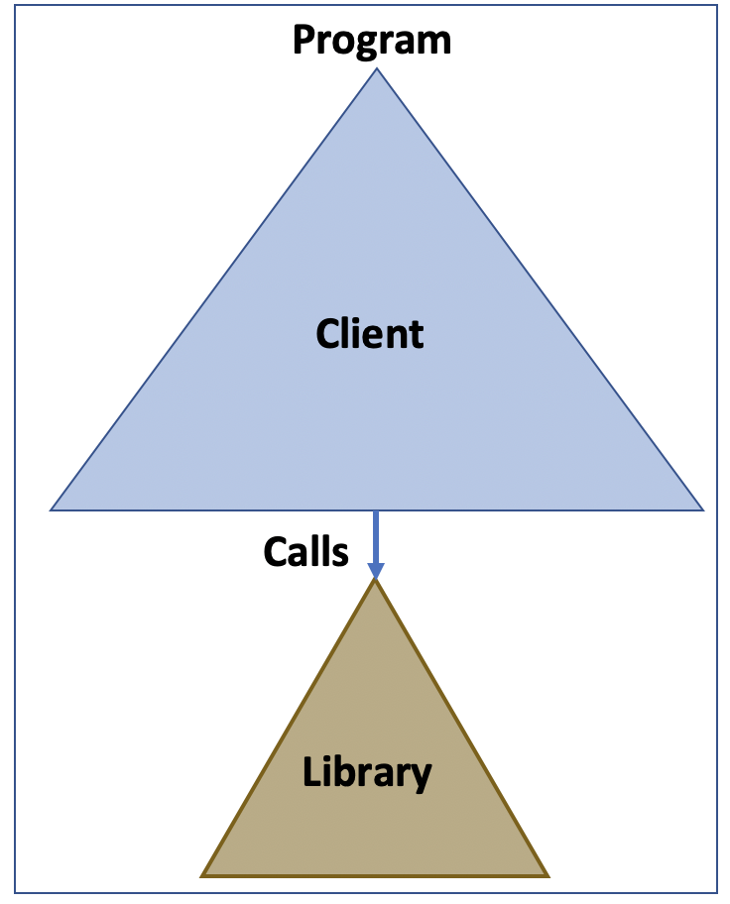
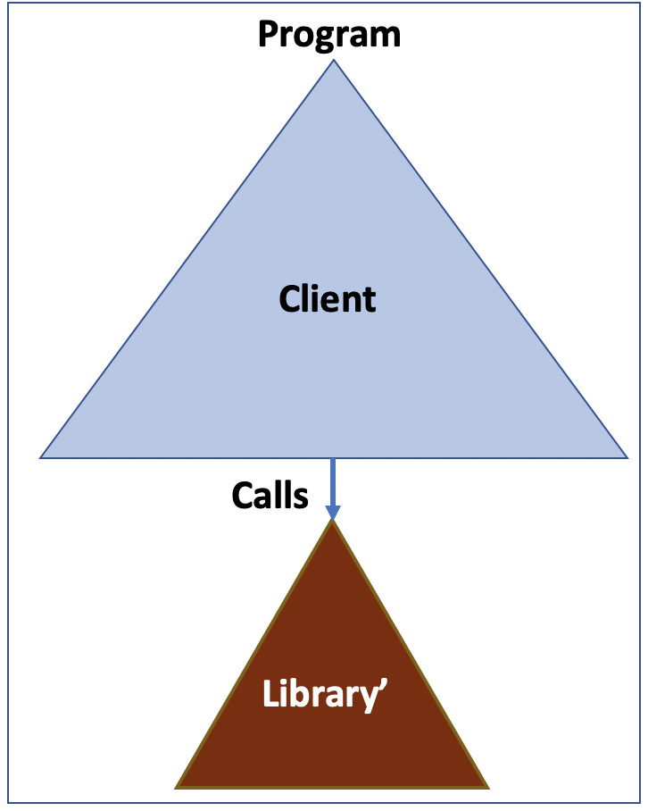
Equivalence Checking
=
Inputs
Inputs
?
1
=
Output
Output

Slide 2
Equivalence Checking
=
Inputs
Inputs
Programs P and P’ are equal iff for all x, P(x) = P’(x)
?
2
=
Output
Output

Slide 3
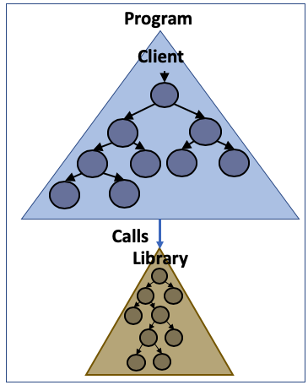
Symbolic Execution
Inputs
Symbolic Execution Tree
Each node represents the execution of a program statement
3
Output

Slide 4
Symbolic Execution
Symbolic Value
x=α
def client(x):
1: if (x>0):
2: return lib(x)
3: else:
4: if (x==0):
5: return 0
6: else:
7: return cos(x)
Running program with symbolic values rather that concrete values
4
Notes:
Execute the program with symbolic valued inputs

Slide 5
Symbolic Execution
Symbolic Value
x=α
def client(x):
1: if (x>0):
2: return lib(x)
3: else:
4: if (x==0):
5: return 0
6: else:
7: return cos(x)
1
α>?0
F
T
5
Notes:
Execute the program with symbolic valued inputs

Slide 6
Symbolic Execution
Symbolic Value
x=α
Path Condition
def client(x):
1: if (x>0):
2: return lib(x)
3: else:
4: if (x==0):
5: return 0
6: else:
7: return cos(x)
1
α>?0
F
T
2
[α>0] x=α ^ Ret =Lib(x)
4
[α<=0] x=α
The conjunction of path constraints over symbolic values
6
Notes:
Execute the program with symbolic valued inputs

Slide 7
Symbolic Execution
Symbolic Value
x=α
Path Condition
def client(x):
1: if (x>0):
2: return lib(x)
3: else:
4: if (x==0):
5: return 0
6: else:
7: return cos(x)
1
α>?0
F
T
2
[α>0] x=α ^ Ret =Lib(x)
4
[α<=0] x=α
T
F
[α<=0 ∧ α==0]
Ret=0
[α<=0 ∧ α!=0]
Ret=cos(α)
5
7
7
Notes:
Execute the program with symbolic valued inputs

Slide 8
Symbolic Execution
Symbolic Value
x=α
Path Condition
def client(x):
1: if (x>0):
2: return lib(x)
3: else:
4: if (x==0):
5: return 0
6: else:
7: return cos(x)
1
α>?0
F
T
2
[α>0] x=α ^ Ret =Lib(x)
4
[α<=0] x=α
T
F
[α<=0 ∧ α==0]
Ret=0
[α<=0 ∧ α!=0]
Ret=cos(α)
5
7
(α>0 ∧ Ret=lib(α))
8
Notes:
Execute the program with symbolic valued inputs

Slide 9
Symbolic Execution
Symbolic Value
x=α
Path Condition
def client(x):
1: if (x>0):
2: return lib(x)
3: else:
4: if (x==0):
5: return 0
6: else:
7: return cos(x)
1
α>?0
F
T
2
[α>0] x=α ^ Ret =Lib(x)
4
[α<=0] x=α
T
F
[α<=0 ∧ α==0]
Ret=0
[α<=0 ∧ α!=0]
Ret=cos(α)
5
7
(α>0 ∧ Ret=lib(α))
(α<=0 ∧ α==0 ∧ Ret=0)
9
Notes:
Execute the program with symbolic valued inputs

Slide 10
Symbolic Execution
Symbolic Value
x=α
Path Condition
def client(x):
1: if (x>0):
2: return lib(x)
3: else:
4: if (x==0):
5: return 0
6: else:
7: return cos(x)
1
α>?0
F
T
2
[α>0] x=α ^ Ret =Lib(x)
4
[α<=0] x=α
T
F
[α<=0 ∧ α==0]
Ret=0
[α<=0 ∧ α!=0]
Ret=cos(α)
5
7
(α>0 ∧ Ret=lib(α))
(α<=0 ∧ α==0 ∧ Ret=0)
(α<=0 ∧ α!=0 ∧ Ret=cos(α))
10
Notes:
Execute the program with symbolic valued inputs

Slide 11
Symbolic Execution
Symbolic Value
x=α
Path Condition
def client(x):
1: if (x>0):
2: return lib(x)
3: else:
4: if (x==0):
5: return 0
6: else:
7: return cos(x)
1
α>?0
F
T
2
[α>0] x=α ^ Ret =Lib(x)
4
[α<=0] x=α
T
F
[α<=0 ∧ α==0]
Ret=0
[α<=0 ∧ α!=0]
Ret=cos(α)
5
7
(α>0 ∧ Ret=lib(α)) ⋁
(α<=0 ∧ α==0 ∧ Ret=0) ⋁
(α<=0 ∧ α!=0 ∧ Ret=cos(α))
The execution can take one of these paths
11
Notes:
Execute the program with symbolic valued inputs

Slide 12
Symbolic Execution
Symbolic Value
x=α
Path Condition
def client(x):
1: if (x>0):
2: return lib(x)
3: else:
4: if (x==0):
5: return 0
6: else:
7: return cos(x)
1
α>?0
F
T
2
[α>0] x=α ^ Ret =Lib(x)
4
[α<=0] x=α
T
F
[α<=0 ∧ α==0]
Ret=0
[α<=0 ∧ α!=0]
Ret=cos(α)
5
7
(α>0 ∧ Ret=lib(α)) ⋁
(α<=0 ∧ α==0 ∧ Ret=0) ⋁
(α<=0 ∧ α!=0 ∧ Ret=cos(α))
Symbolic summary
12
Notes:
Execute the program with symbolic valued inputs

Slide 13
Example
def client(x):
if(x>0):
return lib(x)
else:
return -10
x is an angle
For the first full rotation (0<x<=360), return sin(x)+1
def lib(x):
a = sin(x)
v = 1
if(x<=360):
return a+v
else:
if(a>=0.5):
return a
else:
return 0
For cases with sin(x)>0.5, return sin(x)
13

Slide 14
Example
def client(x):
if(x>0):
return lib(x)
else:
return -10
def client(x):
if(x>0):
return lib(x)
else:
return -10
def lib(x):
a = sin(x)
v = 1
if(x<=360):
return a+v
else:
if(a>=0.5):
return a
else:
return 0
def lib(x):
a = sin(x)
v = 1
if(x<=360):
return a+1
else:
if(round(a)==1):
return a
else:
return 0
The changes
14

Slide 15
Example
def client(x):
if(x>0):
return lib(x)
else:
return -10
def client(x):
if(x>0):
return lib(x)
else:
return -10
def lib(x):
a = sin(x)
v = 1
if(x<=360):
return a+v
else:
if(a>=0.5):
return a
else:
return 0
def lib(x):
a = sin(x)
v = 1
if(x<=360):
return a+1
else:
if(round(a)==1):
return a
else:
return 0
Equivalent
a >= 0.5 && a <=1 ➔ round(a)==1
round(a)==1 ➔ a >= 0.5
15

Slide 16
CLEVER Lazy Exploration Does Not Apply
def client(x):
if(x>0):
return lib(x)
else:
return -10
def client(x):
if(x>0):
return lib(x)
else:
return -10
No concolic counter-example! Can we prove equivalence?
def lib(x):
a = sin(x)
v = 1
if(x<=360):
return a+v
else:
if(a>=0.5):
return a
else:
return 0
def lib(x):
a = sin(x)
v = 1
if(x<=360):
return a+1
else:
if(round(a)==1):
return a
else:
return 0
16

Slide 17
Proving Equivalence
def client(x):
if(x>0):
return lib(x)
else:
return -10
def client(x):
if(x>0):
return lib(x)
else:
return -10
Old:
(x>0 ∧ x≤360 ∧ Ret=v+sin(x)) ⋁
(x>0 ∧ x>360 ∧ sin(x)≥0.5 ∧ Ret=sin(x))⋁
(x>0 ∧ x>360 ∧ sin(x)<0.5 ∧ Ret=0)
def lib(x):
a = sin(x)
v = 1
if(x<=360):
return a+v
else:
if(a>=0.5):
return a
else:
return 0
def lib(x):
a = sin(x)
v = 1
if(x<=360):
return a+1
else:
if(round(a)==1):
return a
else:
return 0
New:
(x>0 ∧ x≤360 ∧ Ret=1+sin(x)) ⋁
(x>0 ∧ x>360 ∧ round(sin(x))==1 ∧ Ret=sin(x))⋁
(x>0 ∧ x>360 ∧ round(sin(x))!=1 ∧ Ret=0)
17

Slide 18
Proving Equivalence: Does Not Work
Complexity in the changed paths
def client(x):
if(x>0):
return lib(x)
else:
return -10
def client(x):
if(x>0):
return lib(x)
else:
return -10
Old:
(x>0 ∧ x≤360 ∧ Ret=v+sin(x)) ⋁
(x>0 ∧ x>360 ∧ sin(x)≥0.5 ∧ Ret=sin(x))⋁
(x>0 ∧ x>360 ∧ sin(x)<0.5 ∧ Ret=0)
def lib(x):
a = sin(x)
v = 1
if(x<=360):
return a+v
else:
if(a>=0.5):
return a
else:
return 0
def lib(x):
a = sin(x)
v = 1
if(x<=360):
return a+1
else:
if(round(a)==1):
return a
else:
return 0
New:
(x>0 ∧ x≤360 ∧ Ret=1+sin(x)) ⋁
(x>0 ∧ x>360 ∧ round(sin(x))==1 ∧ Ret=sin(x))⋁
(x>0 ∧ x>360 ∧ round(sin(x))!=1 ∧ Ret=0)
Old ⟺ New => SMT
I Don’t Know!
18

Slide 19
Leverage Commonalities in Corresponding Paths
Insights:
There are commonalities between these client-specific paths in two libraries.
def client(x):
if(x>0):
return lib(x)
else:
return -10
def client(x):
if(x>0):
return lib(x)
else:
return -10
def lib(x):
a = sin(x)
v = 1
if(x<=360):
return a+v
else:
if(a>=0.5):
return a
else:
return 0
def lib(x):
a = sin(x)
v = 1
if(x<=360):
return a+1
else:
if(round(a)==1):
return a
else:
return 0
19
[*] Suzette Person, Matthew B. Dwyer, Sebastian Elbaum, and Corina S. Pasareanu. Differential Symbolic Execution. In Proc. of SIGSOFT FSE. 2008.

Slide 20
Leverage Commonalities in Corresponding Paths
Insights:
There are commonalities between these client-specific paths in two libraries.
def client(x):
if(x>0):
return lib(x)
else:
return -10
def client(x):
if(x>0):
return lib(x)
else:
return -10
def lib(x):
a = sin(x)
v = 1
if(x<=360):
return a+v
else:
if(a>=0.5):
return a
else:
return 0
def lib(x):
a = sin(x)
v = 1
if(x<=360):
return a+1
else:
if(round(a)==1):
return a
else:
return 0
Abstract common statements with uninterpreted functions
Use Equality of uninterpreted functions
20
[*] Suzette Person, Matthew B. Dwyer, Sebastian Elbaum, and Corina S. Pasareanu. Differential Symbolic Execution. In Proc. of SIGSOFT FSE. 2008.

Slide 21
Leverage Commonalities in Corresponding Paths
Common code P
def client(x):
if(x>0):
return lib(x)
else:
return -10
def client(x):
if(x>0):
return lib(x)
else:
return -10
def lib(x):
a = sin(x)
v = 1
if(x<=360):
return a+v
else:
if(a>=0.5):
return a
else:
return 0
def lib(x):
a = sin(x)
v = 1
if(x<=360):
return a+1
else:
if(round(a)==1):
return a
else:
return 0
21
[*] Suzette Person, Matthew B. Dwyer, Sebastian Elbaum, and Corina S. Pasareanu. Differential Symbolic Execution. In Proc. of SIGSOFT FSE. 2008.

Slide 22
Leverage Commonalities in Corresponding Paths
Common code P
def client(x):
if(x>0):
return lib(x)
else:
return -10
def client(x):
if(x>0):
return lib(x)
else:
return -10
Identify inputs and outputs of P
def lib(x):
a = sin(x)
v = 1
if(x<=360):
return a+v
else:
if(a>=0.5):
return a
else:
return 0
def lib(x):
a = sin(x)
v = 1
if(x<=360):
return a+1
else:
if(round(a)==1):
return a
else:
return 0
22
[*] Suzette Person, Matthew B. Dwyer, Sebastian Elbaum, and Corina S. Pasareanu. Differential Symbolic Execution. In Proc. of SIGSOFT FSE. 2008.

Slide 23
Leverage Commonalities in Corresponding Paths
Common code P
def client(x):
if(x>0):
return lib(x)
else:
return -10
def client(x):
if(x>0):
return lib(x)
else:
return -10
Identify inputs and outputs of P
Inputs: x
Outputs: a, v
def lib(x):
a = sin(x)
v = 1
if(x<=360):
return a+v
else:
if(a>=0.5):
return a
else:
return 0
def lib(x):
a = sin(x)
v = 1
if(x<=360):
return a+1
else:
if(round(a)==1):
return a
else:
return 0
23
[*] Suzette Person, Matthew B. Dwyer, Sebastian Elbaum, and Corina S. Pasareanu. Differential Symbolic Execution. In Proc. of SIGSOFT FSE. 2008.

Slide 24
Leverage Commonalities in Corresponding Paths
Common code P
def client(x):
if(x>0):
return lib(x)
else:
return -10
def client(x):
if(x>0):
return lib(x)
else:
return -10
Identify inputs and outputs of P
Abstract outputs with uninterpreted functions
Inputs: x
Outputs: a, v
def lib(x):
a = sin(x)
v = 1
if(x<=360):
return a+v
else:
if(a>=0.5):
return a
else:
return 0
def lib(x):
a = sin(x)
v = 1
if(x<=360):
return a+1
else:
if(round(a)==1):
return a
else:
return 0
Outputs:
UFa(x), UFv(x)
24
[*] Suzette Person, Matthew B. Dwyer, Sebastian Elbaum, and Corina S. Pasareanu. Differential Symbolic Execution. In Proc. of SIGSOFT FSE. 2008.

Slide 25
Leverage Commonalities in Corresponding Paths
Common code P
def client(x):
if(x>0):
return lib(x)
else:
return -10
def client(x):
if(x>0):
return lib(x)
else:
return -10
Identify inputs and outputs of P
Abstract outputs with uninterpreted functions
Embed uninterpreted functions into the summaries
Inputs: x
Outputs: a, v
def lib(x):
a = sin(x)
v = 1
if(x<=360):
return a+v
else:
if(a>=0.5):
return a
else:
return 0
def lib(x):
a = sin(x)
v = 1
if(x<=360):
return a+1
else:
if(round(a)==1):
return a
else:
return 0
Outputs:
UFa(x), UFv(x)
25
[*] Suzette Person, Matthew B. Dwyer, Sebastian Elbaum, and Corina S. Pasareanu. Differential Symbolic Execution. In Proc. of SIGSOFT FSE. 2008.

Slide 26
Leverage Commonalities in Corresponding Paths
Old:
(x>0 ∧ x≤360 ∧ Ret=UF_{v}(x)+UF_{a}(x)) ⋁
(x>0 ∧ x>360 ∧ UF_{a}(x)≥0.5 ∧ Ret=UF_{a}(x))⋁
(x>0 ∧ x>360 ∧ UF_{a}(x)<0.5 ∧ Ret=0)
def client(x):
if(x>0):
return lib(x)
else:
return -10
def client(x):
if(x>0):
return lib(x)
else:
return -10
New:
(x>0 ∧ x≤360 ∧ Ret=1+UF_{a}(x)) ⋁
(x>0 ∧ x>360 ∧ round(UF_{a}(x))==1 ∧ Ret=UF_{a}(x))⋁
(x>0 ∧ x>360 ∧ round(UF_{a}(x))!=1 ∧ Ret=0)
def lib(x):
a = sin(x)
v = 1
if(x<=360):
return a+v
else:
if(a>=0.5)=0.5):
return a
else:
return 0
def lib(x):
a = sin(x)
v = 1
if(x<=360):
return a+1
else:
if(round(a)==1):
return a
else:
return 0
Embed uninterpreted functions into summaries
26
[*] Suzette Person, Matthew B. Dwyer, Sebastian Elbaum, and Corina S. Pasareanu. Differential Symbolic Execution. In Proc. of SIGSOFT FSE. 2008.

Slide 27
Leverage Commonalities in Corresponding Paths
Old:
(x>0 ∧ x≤360 ∧ Ret=UF_{v}(x)+UF_{a}(x)) ⋁
(x>0 ∧ x>360 ∧ UF_{a}(x)≥0.5 ∧ Ret=UF_{a}(x))⋁
(x>0 ∧ x>360 ∧ UF_{a}(x)<0.5 ∧ Ret=0)
def client(x):
if(x>0):
return lib(x)
else:
return -10
def client(x):
if(x>0):
return lib(x)
else:
return -10
New:
(x>0 ∧ x≤360 ∧ Ret=1+UF_{a}(x)) ⋁
(x>0 ∧ x>360 ∧ round(UF_{a}(x))==1 ∧ Ret=UF_{a}(x))⋁
(x>0 ∧ x>360 ∧ round(UF_{a}(x))!=1 ∧ Ret=0)
def lib(x):
a = sin(x)
v = 1
if(x<=360):
return a+v
else:
if(a>=0.5)=0.5):
return a
else:
return 0
def lib(x):
a = sin(x)
v = 1
if(x<=360):
return a+1
else:
if(round(a)==1):
return a
else:
return 0
Old ⟺ New => SMT
27
[*] Suzette Person, Matthew B. Dwyer, Sebastian Elbaum, and Corina S. Pasareanu. Differential Symbolic Execution. In Proc. of SIGSOFT FSE. 2008.

Slide 28
Leverage Commonalities in Corresponding Paths
Old:
(x>0 ∧ x≤360 ∧ Ret=UF_{v}(x)+UF_{a}(x)) ⋁
(x>0 ∧ x>360 ∧ UF_{a}(x)≥0.5 ∧ Ret=UF_{a}(x))⋁
(x>0 ∧ x>360 ∧ UF_{a}(x)<0.5 ∧ Ret=0)
def client(x):
if(x>0):
return lib(x)
else:
return -10
def client(x):
if(x>0):
return lib(x)
else:
return -10
New:
(x>0 ∧ x≤360 ∧ Ret=1+UF_{a}(x)) ⋁
(x>0 ∧ x>360 ∧ round(UF_{a}(x))==1 ∧ Ret=UF_{a}(x))⋁
(x>0 ∧ x>360 ∧ round(UF_{a}(x))!=1 ∧ Ret=0)
def lib(x):
a = sin(x)
v = 1
if(x<=360):
return a+v
else:
if(a>=0.5)=0.5):
return a
else:
return 0
def lib(x):
a = sin(x)
v = 1
if(x<=360):
return a+1
else:
if(round(a)==1):
return a
else:
return 0
Old ⟺ New => SMT
I don’t know if UF_{v}(x) can be equal to 1
28
[*] Suzette Person, Matthew B. Dwyer, Sebastian Elbaum, and Corina S. Pasareanu. Differential Symbolic Execution. In Proc. of SIGSOFT FSE. 2008.

Slide 29
Context-Aware Commonalities in Corresponding Paths
Insight:
Abstracting all common code does not always work
def client(x):
if(x>0):
return lib(x)
else:
return -10
def client(x):
if(x>0):
return lib(x)
else:
return -10
def lib(x):
a = sin(x)
v = 1
if(x<=360):
return a+v
else:
if(a>=0.5):
return a
else:
return 0
def lib(x):
a = sin(x)
v = 1
if(x<=360):
return a+1
else:
if(round(a)==1):
return a
else:
return 0
29

Slide 30
Context-Aware Commonalities in Corresponding Paths
Insights:
Abstracting all common code does not always work
def client(x):
if(x>0):
return lib(x)
else:
return -10
def client(x):
if(x>0):
return lib(x)
else:
return -10
def lib(x):
a = sin(x)
v = 1
if(x<=360):
return a+v
else:
if(a>=0.5):
return a
else:
return 0
def lib(x):
a = sin(x)
v = 1
if(x<=360):
return a+1
else:
if(round(a)==1):
return a
else:
return 0
Context-aware abstraction
Keep UF_{a}(x)
Backtrack variable v
Expand UF_{v}(x) to 1
30

Slide 31
Context-Aware Commonalities in Corresponding Paths
Old:
(x>0 ∧ x≤360 ∧ Ret=1+UF_{a}(x)) ⋁
(x>0 ∧ x>360 ∧ UF_{a}(x)≥0.5 ∧ Ret=UF_{a}(x))⋁
(x>0 ∧ x>360 ∧ UF_{a}(x)<0.5 ∧ Ret=0)
def client(x):
if(x>0):
return lib(x)
else:
return -10
def client(x):
if(x>0):
return lib(x)
else:
return -10
New:
(x>0 ∧ x≤360 ∧ Ret=1+UF_{a}(x)) ⋁
(x>0 ∧ x>360 ∧ round(UF_{a}(x))==1 ∧ Ret=UF_{a}(x))⋁
(x>0 ∧ x>360 ∧ round(UF_{a}(x))!=1 ∧ Ret=0)
def lib(x):
a = sin(x)
v = 1
if(x<=360):
return a+v
else:
if(a>=0.5)>=0.5):
return a
else:
return 0
def lib(x):
a = sin(x)
v = 1
if(x<=360):
return a+1
else:
if(round(a)==1):
return a
else:
return 0
Keep UF_{a}(x) Expand UF_{v}(x) to 1
31

Slide 32
Context-Aware Commonalities in Corresponding Paths
Old:
(x>0 ∧ x≤360 ∧ Ret=1+UF_{a}(x)) ⋁
(x>0 ∧ x>360 ∧ UF_{a}(x)≥0.5 ∧ Ret=UF_{a}(x))⋁
(x>0 ∧ x>360 ∧ UF_{a}(x)<0.5 ∧ Ret=0)
def client(x):
if(x>0):
return lib(x)
else:
return -10
def client(x):
if(x>0):
return lib(x)
else:
return -10
New:
(x>0 ∧ x≤360 ∧ Ret=1+UF_{a}(x)) ⋁
(x>0 ∧ x>360 ∧ round(UF_{a}(x))==1 ∧ Ret=UF_{a}(x))⋁
(x>0 ∧ x>360 ∧ round(UF_{a}(x))!=1 ∧ Ret=0)
def lib(x):
a = sin(x)
v = 1
if(x<=360):
return a+v
else:
if(a>=0.5)>=0.5):
return a
else:
return 0
def lib(x):
a = sin(x)
v = 1
if(x<=360):
return a+1
else:
if(round(a)==1):
return a
else:
return 0
Keep UF_{a}(x) Expand UF_{v}(x) to 1
32

Slide 33
Context-Aware Commonalities in Corresponding Paths
Old:
(x>0 ∧ x≤360 ∧ Ret=1+UF_{a}(x)) ⋁
(x>0 ∧ x>360 ∧ UF_{a}(x)≥0.5 ∧ Ret=UF_{a}(x))⋁
(x>0 ∧ x>360 ∧ UF_{a}(x)<0.5 ∧ Ret=0)
def client(x):
if(x>0):
return lib(x)
else:
return -10
def client(x):
if(x>0):
return lib(x)
else:
return -10
New:
(x>0 ∧ x≤360 ∧ Ret=1+UF_{a}(x)) ⋁
(x>0 ∧ x>360 ∧ round(UF_{a}(x))==1 ∧ Ret=UF_{a}(x))⋁
(x>0 ∧ x>360 ∧ round(UF_{a}(x))!=1 ∧ Ret=0)
def lib(x):
a = sin(x)
v = 1
if(x<=360):
return a+v
else:
if(a>=0.5)>=0.5):
return a
else:
return 0
def lib(x):
a = sin(x)
v = 1
if(x<=360):
return a+1
else:
if(round(a)==1):
return a
else:
return 0
Old ⟺ New => SMT
I don’t know!
33

Slide 34
Context-Aware Commonalities in Corresponding Paths
Old:
(x>0 ∧ x≤360 ∧ Ret=1+UF_{a}(x)) ⋁
(x>0 ∧ x>360 ∧ sin(x)≥0.5 ∧ Ret=sin(x))⋁
(x>0 ∧ x>360 ∧ sin(x)<0.5 ∧ Ret=0)
def client(x):
if(x>0):
return lib(x)
else:
return -10
def client(x):
if(x>0):
return lib(x)
else:
return -10
New:
(x>0 ∧ x≤360 ∧ Ret=1+UF_{a}(x)) ⋁
(x>0 ∧ x>360 ∧ round(sin(x))==1 ∧ Ret=sin(x))⋁
(x>0 ∧ x>360 ∧ round(sin(x))!=1 ∧ Ret=0)
def lib(x):
a = sin(x)
v = 1
if(x<=360):
return a+v
else:
if(a>=0.5)>=0.5):
return a
else:
return 0
def lib(x):
a = sin(x)
v = 1
if(x<=360):
return a+1
else:
if(round(a)==1):
return a
else:
return 0
Old ⟺ New => SMT
I don’t know!
34

Slide 35
Leverage Path Equivalence
def client(x):
if(x>0):
return lib(x)
else:
return -10
def client(x):
if(x>0):
return lib(x)
else:
return -10
Insights:
Use Shadow Symbolic Execution to identify corresponding paths.
For each corresponding paths, ignore the path condition, and only compare the return statements
def lib(x):
a = sin(x)
v = 1
if(x<=360):
return a+v
else:
if(a>=0.5)0.5):
return a
else:
return 0
def lib(x):
a = sin(x)
v = 1
if(x<=360):
return a+1
else:
if(round(a)==1):
return a
else:
return 0
35
[*] Cristian Cadar and Hristina Palikareva. 2014. Shadow Symbolic Execution for Better Testing of Evolving Software. In Proc. of ICSE NIER’14. 432–435.

Slide 36
Leverage Path Equivalence
def client(x):
if(x>0):
return lib(x)
else:
return -10
def client(x):
if(x>0):
return lib(x)
else:
return -10
def lib(x):
a = sin(x)
v = 1
if(x<=360):
return a+v
else:
if(a>=0.5):
return a
else:
return 0
sin(x)>=0.5 is corresponding to round(sin(x))==1
def lib(x):
a = sin(x)
v = 1
if(x<=360):
return a+1
else:
if(round(a)==1):
return a
else:
return 0
sin(x)<0.5 is corresponding to round(sin(x))!=1
36

Slide 37
Leverage Path Equivalence
Old:
(x>0 ∧ x≤360 ∧ Ret=1+UF_{a}(x)) ⋁
(x>0 ∧ x>360 ∧ sin(x)≥0.5 ∧ Ret=sin (x))⋁
(x>0 ∧ x>360 ∧ sin(x)<0.5 ∧ Ret=0)
def client(x):
if(x>0):
return lib(x)
else:
return -10
def client(x):
if(x>0):
return lib(x)
else:
return -10
New:
(x>0 ∧ x≤360 ∧ Ret=1+UF_{a}(x)) ⋁
(x>0 ∧ x>360 ∧ round(sin (x))==1 ∧ Ret=sin(x))⋁
(x>0 ∧ x>360 ∧ round(sin (x))!=1 ∧ Ret=0)
def lib(x):
a = sin(x)
v = 1
if(x<=360):
return a+v
else:
if(a>=0.5)>=0.5):
return a
else:
return 0
def lib(x):
a = sin(x)
v = 1
if(x<=360):
return a+1
else:
if(round(a)==1):
return a
else:
return 0
Ignore the path condition, and only compare the corresponding return statements
37

Slide 38
Leverage Path Equivalence
Old:
(x>0 ∧ x≤360 ∧ Ret=1+UF_{a}(x)) ⋁
(x>0 ∧ x>360 ∧ sin(x)≥0.5 ∧ Ret=sin (x))⋁
(x>0 ∧ x>360 ∧ sin(x)<0.5 ∧ Ret=0)
def client(x):
if(x>0):
return lib(x)
else:
return -10
def client(x):
if(x>0):
return lib(x)
else:
return -10
New:
(x>0 ∧ x≤360 ∧ Ret=1+UF_{a}(x)) ⋁
(x>0 ∧ x>360 ∧ round(sin (x))==1 ∧ Ret=sin(x))⋁
(x>0 ∧ x>360 ∧ round(sin (x))!=1 ∧ Ret=0)
def lib(x):
a = sin(x)
v = 1
if(x<=360):
return a+v
else:
if(a>=0.5)>=0.5):
return a
else:
return 0
def lib(x):
a = sin(x)
v = 1
if(x<=360):
return a+1
else:
if(round(a)==1):
return a
else:
return 0
Ignore the path condition, and only compare the corresponding return statements
38

Slide 39
Leverage Path Equivalence
Old:
(x>0 ∧ x≤360 ∧ Ret=1+UF_{a}(x)) ⋁
(x>0 ∧ x>360 ∧ sin(x)≥0.5 ∧ Ret=sin (x))⋁
(x>0 ∧ x>360 ∧ sin(x)<0.5 ∧ Ret=0)
def client(x):
if(x>0):
return lib(x)
else:
return -10
def client(x):
if(x>0):
return lib(x)
else:
return -10
New:
(x>0 ∧ x≤360 ∧ Ret=1+UF_{a}(x)) ⋁
(x>0 ∧ x>360 ∧ round(sin (x))==1 ∧ Ret=sin(x))⋁
(x>0 ∧ x>360 ∧ round(sin (x))!=1 ∧ Ret=0)
def lib(x):
a = sin(x)
v = 1
if(x<=360):
return a+v
else:
if(a>=0.5)>=0.5):
return a
else:
return 0
def lib(x):
a = sin(x)
v = 1
if(x<=360):
return a+1
else:
if(round(a)==1):
return a
else:
return 0
Old ⟺ New => SMT
Equivalent!
39

